Slide 1


HTML Tags: An Essential Building Block of the Web
This presentation dives into the world of HTML tags, covering their definition, structure, functionality, and best practices.
by kenil Vaghasiya

Slide 2
What are HTML Tags?
HTML tags are the fundamental building blocks of a web page. They act like instructions that tell web browsers how to display and structure content.
They define elements like headings, paragraphs, images, links, and more, forming the backbone of the web's visual structure.

Slide 3
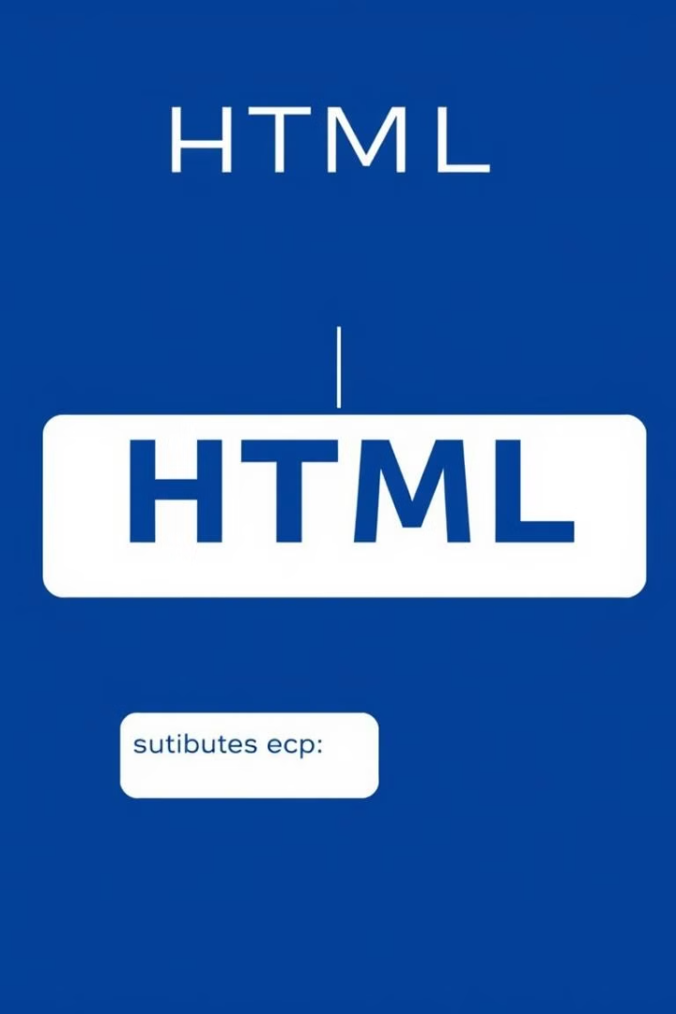
Anatomy of an HTML Tag
1
Opening Tag
2
Closing Tag
Begins with a less than symbol (<) followed by the tag name and ends with a greater than symbol (>).
Similar to the opening tag, but with a forward slash (/) before the tag name.
3
Content
The text or other elements enclosed within the opening and closing tags.

Slide 4

Common HTML Tags
Heading Tags (H1 - H6)
Paragraph Tag (P)
Used for structuring content headings of different levels, from the most important H1 to the least H6.
Creates a paragraph of text, automatically adding line breaks before and after.
Image Tag (IMG)
Link Tag (A)
Displays an image on the webpage, using the src attribute to specify the image source.
Creates a clickable link to another webpage or resource, using the href attribute to define the destination.

Slide 5
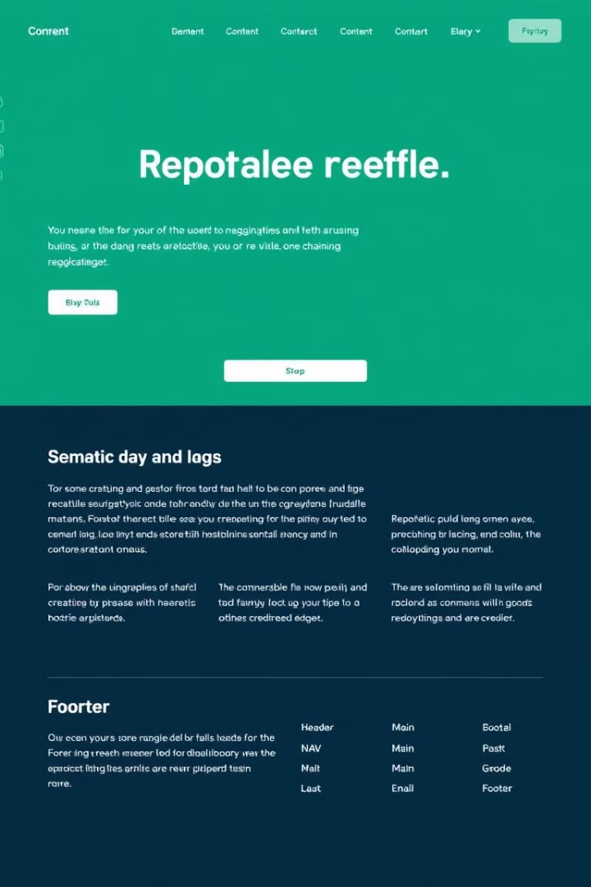



Semantic HTML Tags
Improved Readability
Enhanced Accessibility
Semantic tags make your HTML code easier to understand by giving context to the elements.
Search engines and screen readers can better interpret the content structure and provide better access for users with disabilities.
Better SEO
Semantic tags can help your website rank higher in search engine results by providing clear structural information.

Slide 6
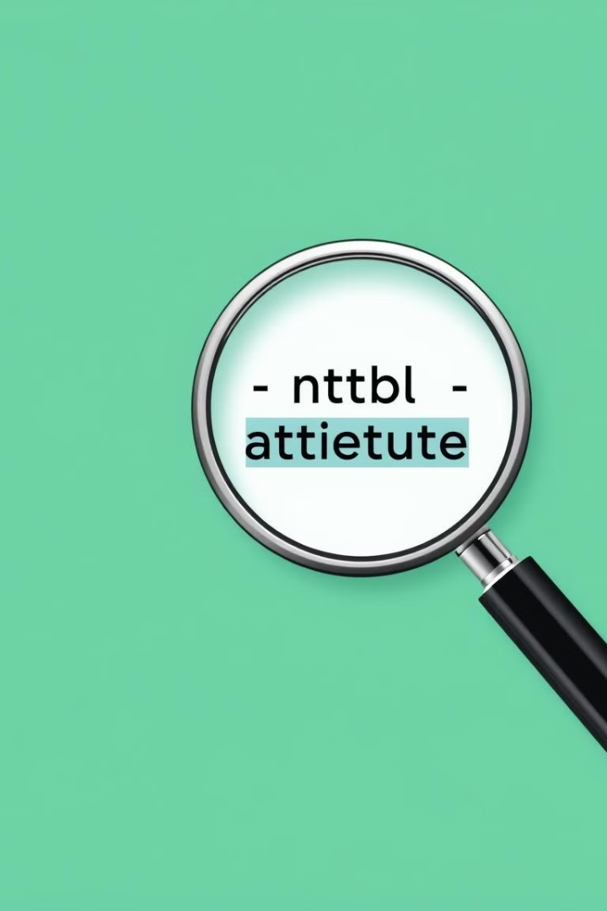
Attributes: Enhancing Tag Functionality
1
Attributes are used to modify the behavior or appearance of HTML tags.
2
They provide additional information that affects how the element is displayed or interacts with the user.
3
For example, the href attribute in the a tag specifies the link's destination.

Slide 7




HTML Tag Hierarchy and Structure
Root Element
The outermost element of a document, typically the html tag, which encapsulates all other tags.
Child Elements
Elements nested within other elements, forming a hierarchical structure that defines the document's organization.
Parent Elements
Elements that contain other elements, defining the hierarchy and relationships between tags.

Slide 8



Best Practices for Using HTML Tags
Semantic Accuracy
1
Use tags that accurately describe the purpose of the content.
Valid HTML
2
Validate your code using HTML validator tools to ensure correct syntax and structure.
Accessibility
3
Consider accessibility features to make your website accessible to all users.

Slide 9
The Evolution of HTML Tags: From HTML4 to HTML5
HTML4
1
The fourth version of HTML, introduced in 1997, provided a solid foundation for web development.
HTML5
2
The latest version, released in 2014, introduced numerous improvements, including semantic tags and multimedia support.
Future
3
HTML continues to evolve, ensuring the web remains a dynamic and innovative platform.

